Slide 1
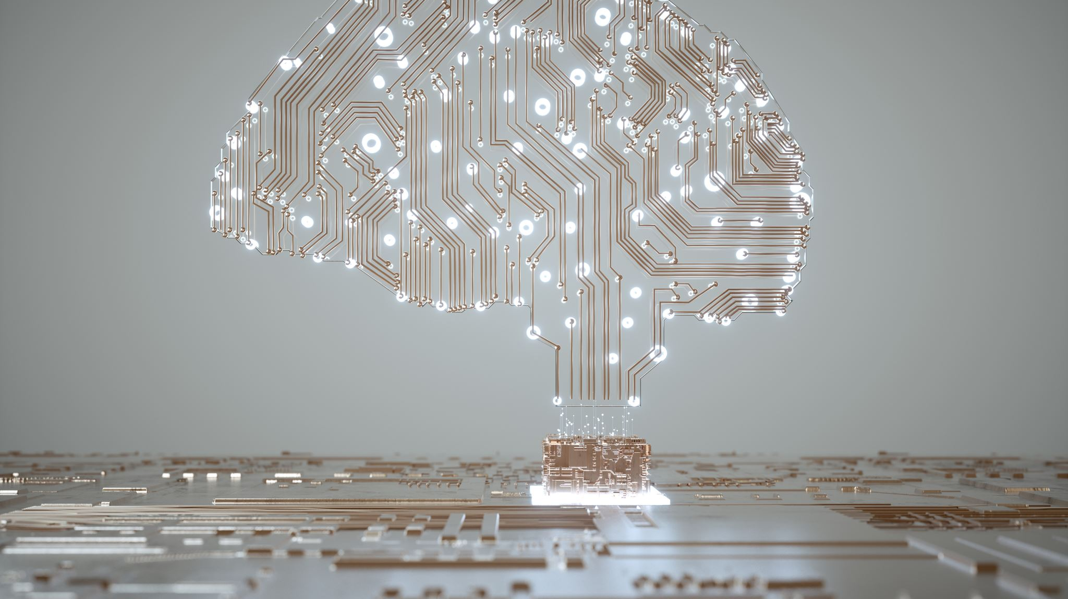
Artificial Intelligence (AI)
Presented by : C.Abirami &
P.Renuka,
Dept of : lll-CS,
From of : Auxilium College of Arts and Science for Women, Regunathapuram,
Date : (25/08/2k23).

Slide 2

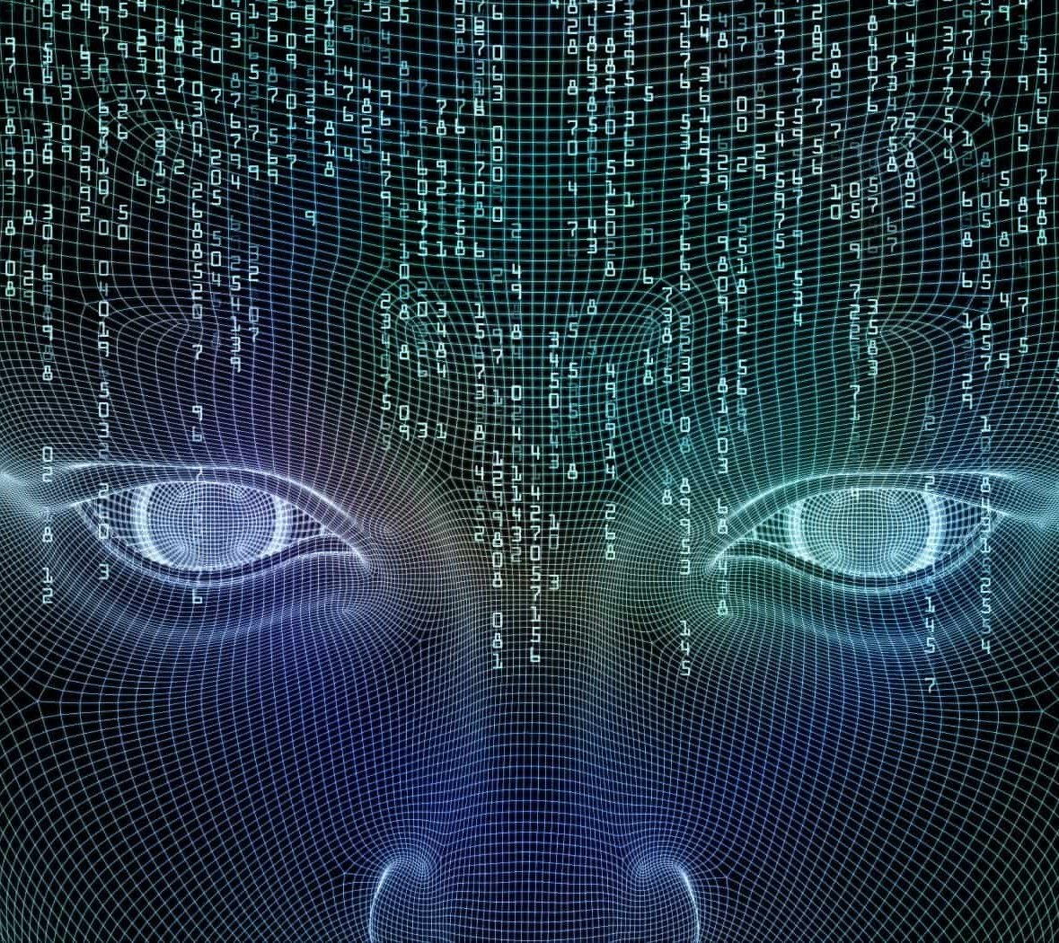
Index
What is Al?
History of AI.
Type of Al.
Benefits of Al.
Al in Daily life.
Future of Al.
Alexa and Siri.
Conclusion.
This Photo by Unknown author is licensed under CC BY-SA-NC.

Slide 3

What is Artificial Intelligence?
Artificial intelligence (AI) is the ability of a computer or a robot controlled by a computer to do tasks that are usually done by humans because they require human intelligence and discernment.
The term AI, coined in the 1950s, refers to the simulation of human intelligence by machines.
These Assistant use NLP ,ML, Statistics Analysis & Algorithmic execution to decide what you are asking for and try to get it for you.
He simulation of human intelligence processes by machines, especially Computer System .

Slide 4
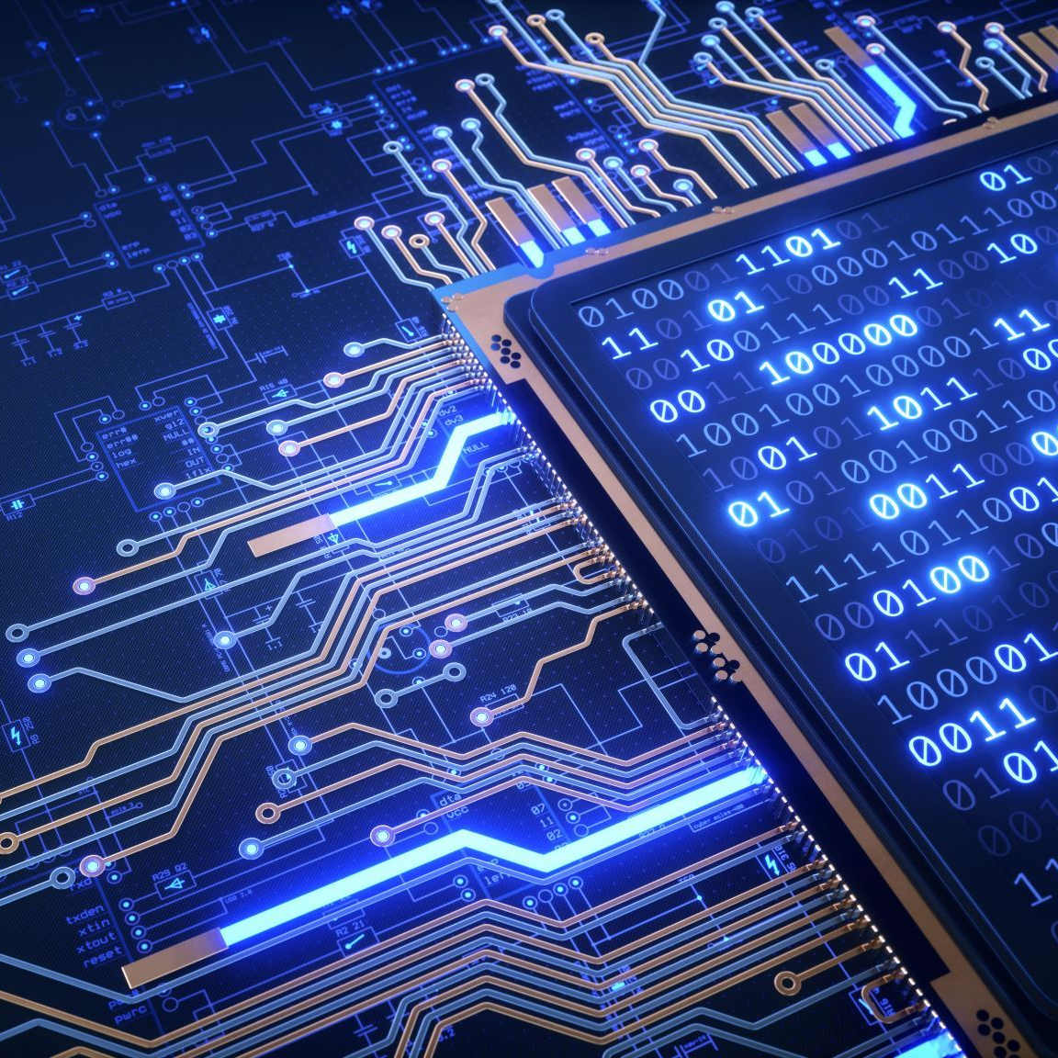
History of Artificial Intelligent:
John McCarthy,is tha father and founder of Al.
Birth of AI: 1950-1956.
1950: Alan Turing he is the first defined In Al.
Dabbala Rajagopal “Raj” Reddy is indian father.
The trio of computer scientists—Yoshua Bengio, Geoffrey Hinton, and Yann LeCun.
The goal of AI is to provide software that can reason on input and explain on output.

Slide 5
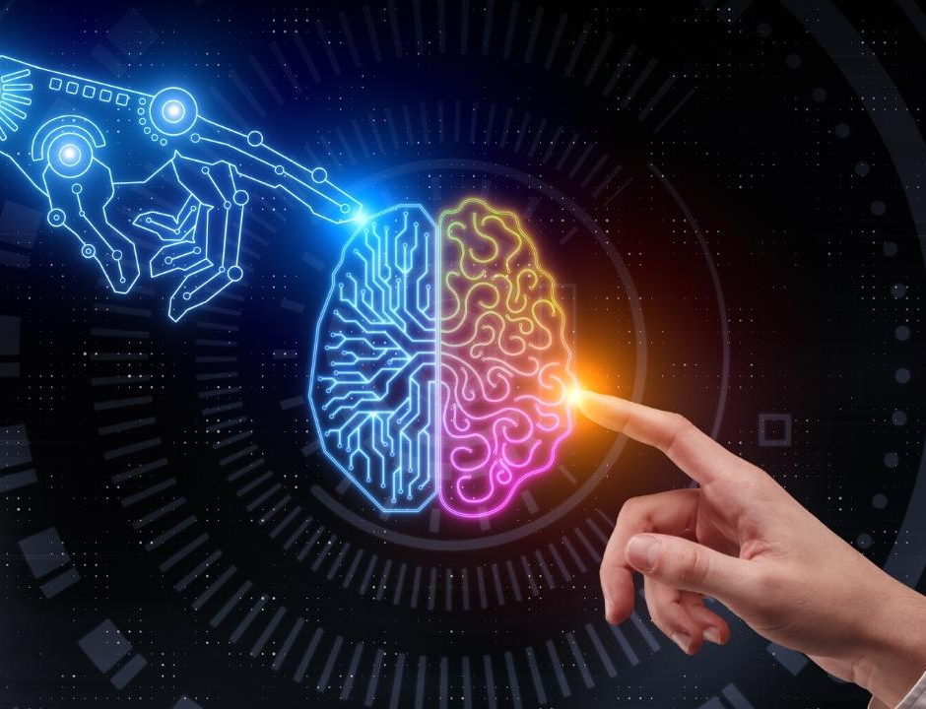
Type of Artificial Intelligence :
There are 7types of Al but it’s most important type is three.
Artificial Narrow Intelligent (ANI).
Artificial General Intelligent (AGI).
Artificial Super Intelligent (ASI).
Reactive Machine.
Limited Memory.
Theory of Mind.
self-Aware.

Slide 6
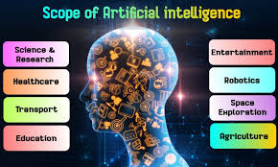

The scope of a bright artificial intelligence future can fuel the development of autonomous vehicles in various industries.
Algorithmic Trainer / Click Worker_They work with AI algorithms and train them to recognize instructions, emotions, moods, images, speech, etc.

Slide 7
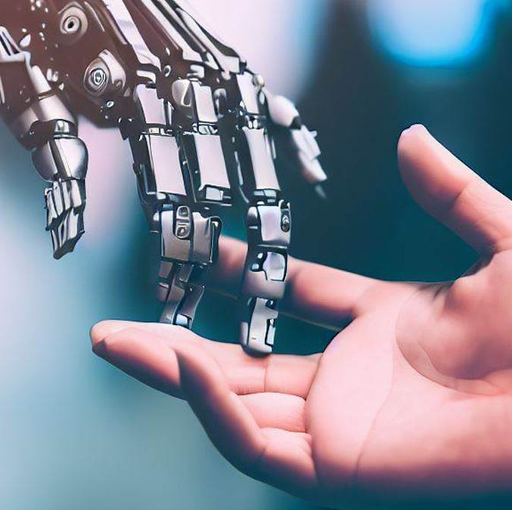
AI in Daily Life:
Here are seven Artificial Intelligence examples in everyday life.
Personal Assistants.
Social media.
Customer service.
Healthcare.
E-commerce.
Autonomous vehicles.
Smart home devices.

Slide 8
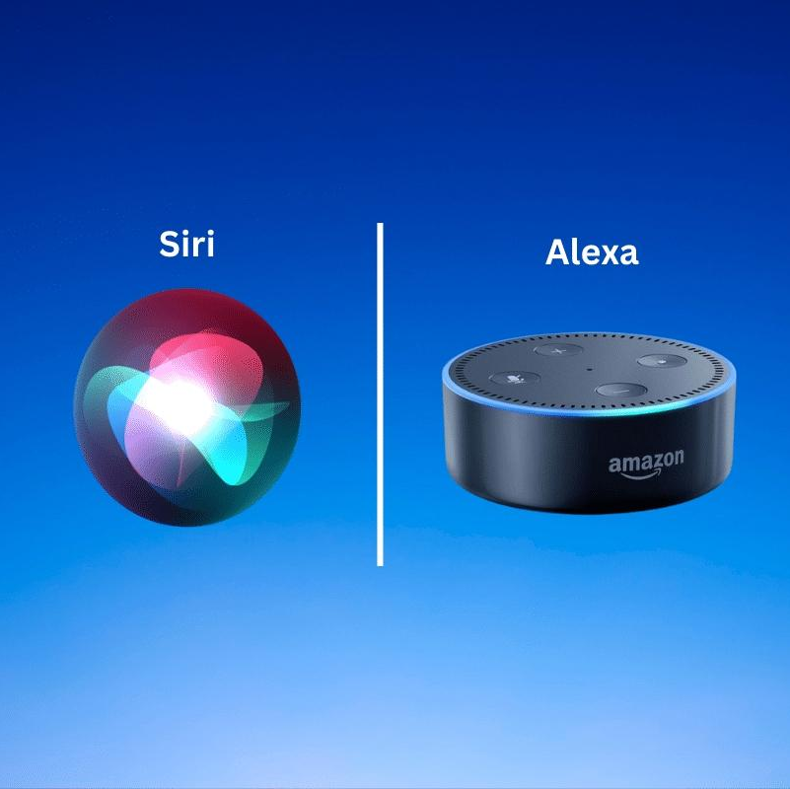
Alexa and Siri:
Alexa is the better option for smart home integration, as it supports a wide range of smart home devices from various brands. Siri is more limited in this regard, as it primarily supports Apple HomeKit-enabled devices.
In contrast Siri, Alexa and Google Assistant are essentially what are known as command-and-control systems.

Slide 9
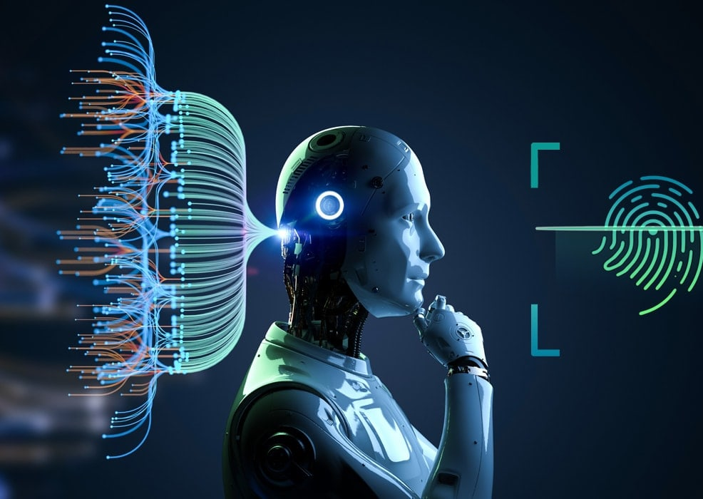
Conclusion:
AI leads to transformative applications within a series of industrial, intellectual, and social applications, far beyond those caused by previous industrial revolutions.
Furthermore, AI has proven to be superior to human decision-making in certain areas.

Slide 10
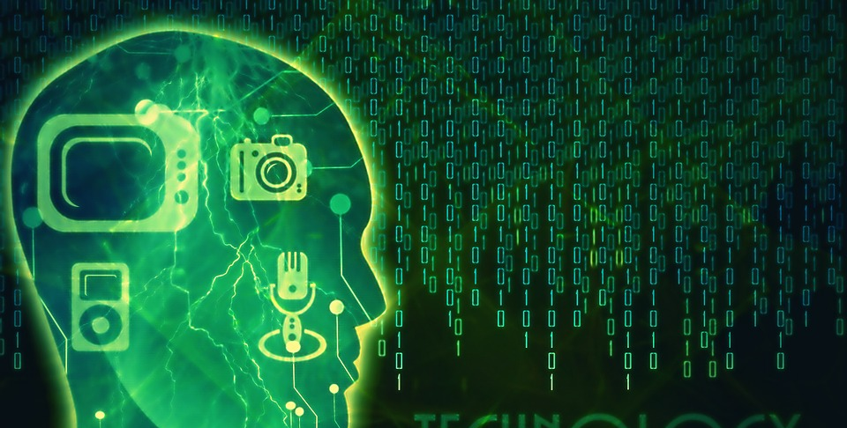
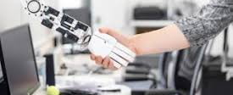
THANK YOU

